Slide 1

SMART INDIA HACKATHON 2026
Problem Statement ID - SIH26001
Problem Statement Title - Landslide Intelligence using Temporal & Hyperlocal Observation System (LITHOS)
Theme - Disaster Management & Climate Resilience
PS Category - Software
Team ID - 26001
Team Name - LITHOS

Slide 2
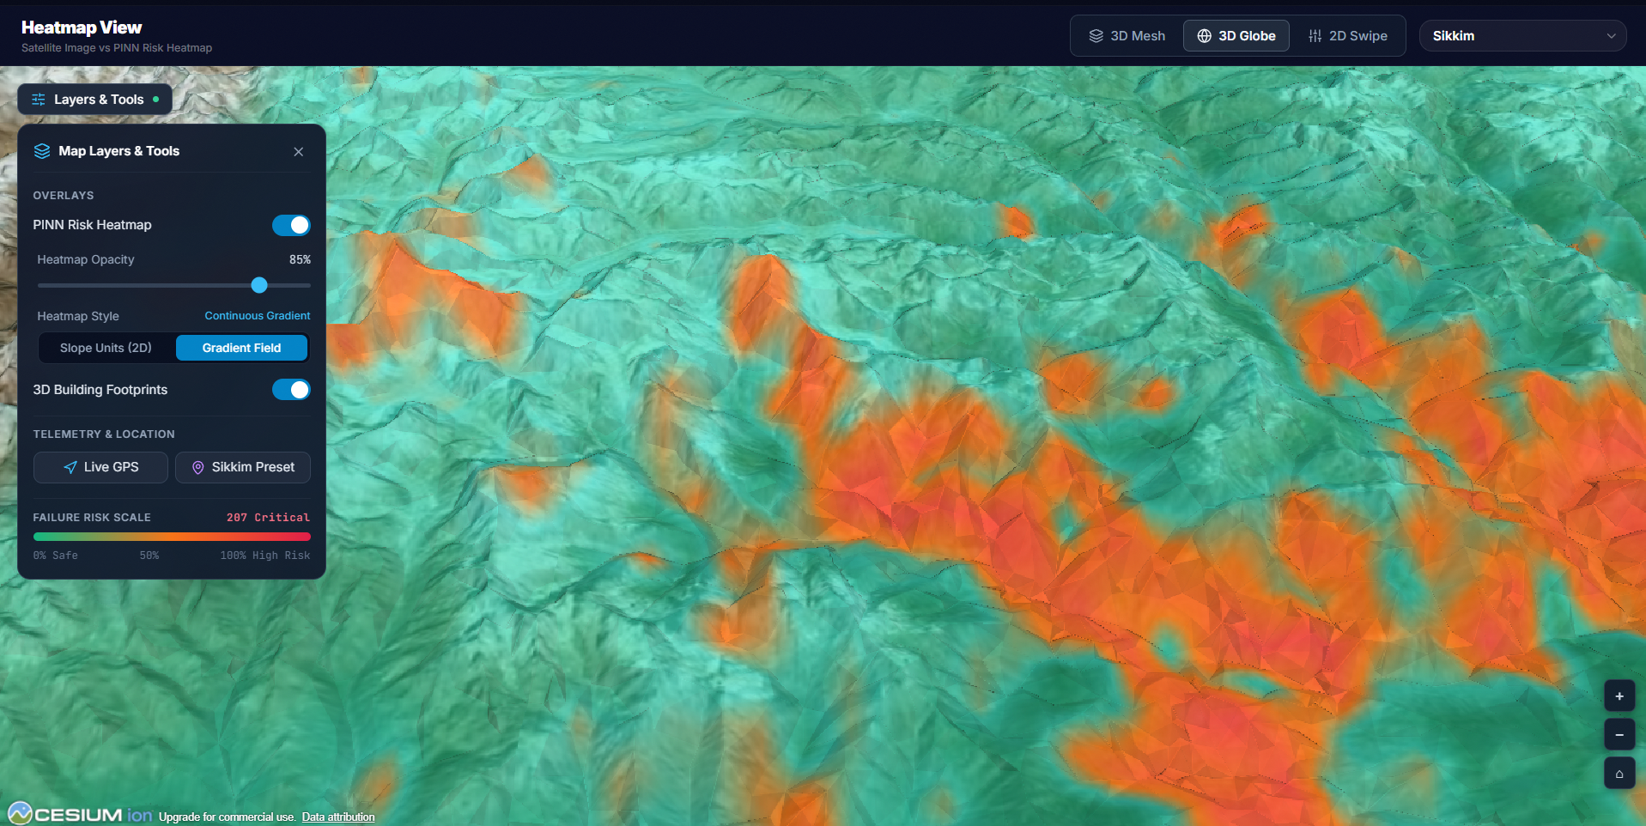
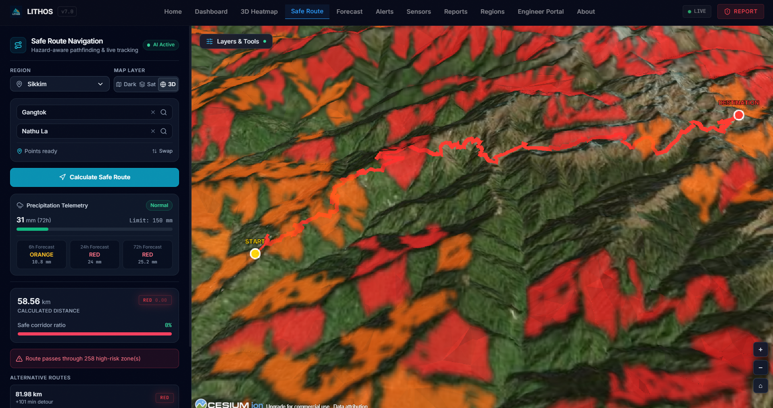
LITHOS
LITHOS: Physics-Informed & InSAR Landslide Early Warning System
Current Challenges:
Conventional alerts rely on coarse 50km block warnings (IMD/GSI), triggering severe false-alarm fatigue. Pure black-box AI models suffer from 'rainfall hallucinations' predicting slides on flat plains, while existing systems are completely blind to pre-failure ground creep.
Our Solution:
An AI-powered PINN & Sentinel-1 InSAR system with Wireless IoT Sensors & Debris Runout Analytics that predicts slope failure across 580,508 hydrological slope units in North-East India, empowering sub-80ms real-time disaster decision intelligence.
Our Unique Value Proposition :
Slope Units: Replaces 291M noisy pixels with natural geomorphological drainage divides across 8 NER states (Alvioli 2016).
Geotechnical Physics Embedding: Enforces Mohr-Coulomb yield & IS 1893 Zone V seismic inertia into PyTorch loss.
Sentinel-1 InSAR & IoT Sensor Fusion: Combines satellite radar creep with field IoT piezometers & MEMS inclinometers for multi-tier ground telemetry.
Cascade Debris Runout Modeling: Traces downslope sediment inundation paths via the empirical Fahrböschung model when FoS < 1.0.
Civil Engineering & A* Routing: Translates hazard into IS 14458 retaining wall designs + dynamic offline safe evacuation.
LITHOS 3D InSAR Hazard Interface
Live Evacuation & Navigation System
Photorealistic 3D WebGIS Features:
- CesiumJS 3D Globe with calibrated factor of safety (FoS) draping across all 580,508 slope units.
Dynamic Safe Routing Features:
- Real-time A* risk-penalized road graph routing around active Red/Orange hazard zones.
-

Slide 3
LITHOS
TECHNICAL APPROACH
Frontend : React 18, CesiumJS (3D Photorealistic Terrain), Leaflet 2D, Vite, TailwindCSS
Backend : FastAPI (Asynchronous Python 3.11), WebSockets Streaming (< 80ms)
Database & Management : PostgreSQL, PostGIS, Cloudflare R2, GeoPandas, Rasterio
AI/ML Models & Libraries : PyTorch 2.4 (PINN), XGBoost, LightGBM, Scikit-Learn
Geodesy & IoT Telemetry : Copernicus Sentinel-1 InSAR, LoRaWAN/4G MEMS Inclinometers & Piezometers
MLOps & Deployment : Docker Containerization, Git, GitHub Actions CI (24/24 CI Tests Passed)
Civil Engineering & PWA : IS 14458 Remediation Portal + IndexedDB Offline Evacuation PWA
Data Sources :
NASA SRTM 30m DEM
(Slope, Aspect, TWI)
Sentinel-1 InSAR Radar
(mm/yr Ground Creep)
IoT Sensors & IMD Gauges
(MEMS Tilt, Piezometers)
Data Ingestion & Preprocessing
- r.slopeunits: 580,508 Terrain Units (5.8 Lakhs)
- GDAL / Rasterio: Geo-Harmonization
- Cohesion (c') & Friction Angle (φ')
Interactive 3D
Dashboard
CesiumJS 3D Globe
Dynamic A* Router
Offline PWA Alerts
Simulation Engine & AI Model
1. Limit Equilibrium FoS Physics:
Mohr-Coulomb + IS 1893 Zone V (k_h=0.18)
2. PyTorch PINN Core:
Constrained loss L = L_data + λ·L_physics
3. Level-2 Stacking Super Learner:
XGBoost, LightGBM, RF & PINN Fusion
4. Monte Carlo Dropout:
50 stochastic passes for uncertainty (σ)
Backend & API
(FastAPI WebSockets)
Prototype Link : https://lithoss.tech

Slide 4
LITHOS
FEASIBILITY AND VIABILITY
Feasibility
Technical : Dual Macro-to-Micro Architecture: Satellite InSAR covers all 580,508 units (5.8 Lakhs), while plug-and-play IoT sensors (MEMS tiltmeters & piezometers) provide live telemetry on critical corridors like NH-10 with sub-80ms queries.
Economic : Zero hardware sensor CapEx. Relies on 100% free open satellite feeds (NASA, ESA, IMD). Cloud infrastructure operates at < ₹1,500 ($18) per month.
Operating : Designed for field disaster responders with zero GIS expertise required. Offline PWA with IndexedDB guarantees access during power blackouts.
Viability
Large potential user base : Protects 45 million citizens, mountain transport, and tribal hamlets across all 8 North-Eastern states.
Nationally Scalable : Vector slope unit architecture readily scales to all 580,000 mountain units in India (Western Ghats, Uttarakhand).
Long-term value : Integrates directly with state departments: NDRF, SDRF, BRO, and MDoNER for active relief deployment.
Economic Impact : Mitigates an estimated ₹450+ Crore annually in highway reconstruction, stranded cargo, and relief.
Effectivity : High generalization with 0.8788 Mean ROC-AUC on unseen states and 0.9273 Ensemble PR-AUC.
NASA & Sentinel-1 InSAR Ingestion
Hydrological Slope-Unit Delineation
Geotechnical Limit-Equilibrium FoS
Physics-Informed Deep Neural Training
Level-2 Stacking Super Learner
Monte Carlo Spatial Uncertainty (σ)
Dynamic A* Evacuation Routing
Photorealistic 3D WebGIS Deployment

Slide 5

LITHOS
IMPACT AND BENEFITS
Benefits
Direct Alignment with National Goals :
- Fulfills the principles of PM's 10-Point DRR Agenda, Sendai Framework Target G, and 'Atmanirbhar Bharat'.
- 100% indigenous software stack with zero foreign proprietary licensing.
Preserving Mountain Lifelines :
- Ensures that vital mountain supply lifelines for defense and civilians remain uninterrupted during monsoons.
Economic Loss Mitigation :
- Saves over ₹450 Crore annually in highway reconstruction, stranded cargo losses, and disaster relief expenses.
Zero Preventable Casualties :
- Real-time early warnings ensure zero lives lost to predictable rain-triggered and creep-accelerated slope failures.
Strengthened Digital India Initiative :
- Connects village disaster outposts directly to state command centers via WebGIS.
Impact on Commuters & Logistics (BRO)
Impact on Remote Hill Hamlets
- Up to 6-12 hours advance warning along vital corridors (NH-10, NH-29)
- Dynamic A* routing redirects military convoys around high-risk slide zones
- Prevents hazardous stranding and multi-week mountain supply blockages
- Hyperlocal slope-unit resolution eliminates false-alarm fatigue
- Offline PWA alerts reach isolated tribal villages before cell towers fail
- Pinpoints safe pedestrian evacuation routes to designated shelters
Impact on First Responders (NDRF, SDRF)
Impact on Infrastructure & Governance
- One-tap SOS distress beacon transmits exact GPS & slope hazard indices
- Top-50 Priority Site ranking allows pre-positioning earthmovers & rescue gear
- Live situational 3D dashboard slashes mobilization response time by > 40%
- Slope cut risk analytics guide engineered retaining walls (IS 14458)
- Mitigates an estimated ₹450+ Crore annually in road rebuilding & relief
- Provides empirical geotechnical zoning for planned urban hill development

Slide 6
LITHOS
RESEARCH AND REFERENCES
Alvioli, M., Marchesini, I., Reichenbach, P., Rossi, M., Ardizzone, F., Fiorucci, F., & Guzzetti, F. (2016). Automatic delineation of slope units in large regions for landslide susceptibility sensitivity. Geomorphology, 268, 87–106. DOI: 10.1016/j.geomorph.2016.05.028 [Foundational paper for LITHOS 580,508 slope unit delineation (5.8 Lakhs)].
Sattar, A., Goswami, A., & Kulkarni, A. V. (2024). Rainfall-induced shallow landslide initiation and threshold dynamics in the Eastern Himalayas. Engineering Geology, 312, 106940. DOI: 10.1016/j.enggeo.2023.106940 [Defines empirical rainfall triggering thresholds].
Raissi, M., Perdikaris, P., & Karniadakis, G. E. (2019). Physics-informed neural networks: A deep learning framework for solving forward and inverse problems. Journal of Computational Physics, 378, 686–707. DOI: 10.1016/j.jcp.2018.10.045 [Basis for LITHOS PINN loss formulation].
Bishop, A. W. (1955). The use of the Slip Circle in the Stability Analysis of Slopes. Géotechnique, 5(1), 7–17. & Skempton, A. W. (1954). The Pore-Pressure Coefficients. Géotechnique, 4(4), 143–147. [Infinite-slope effective stress].
Wasowski, J., & Bovenga, F. (2014). Investigating landslides and unstable slopes with satellite Multi-Temporal InSAR: A review. Engineering Geology, 174, 103–138. DOI: 10.1016/j.enggeo.2014.03.003 [Sentinel-1 InSAR creep detection].
Gal, Y., & Ghahramani, Z. (2016). Dropout as a Bayesian Approximation: Representing Model Uncertainty in Deep Learning. Proc. 33rd ICML, PMLR 48:1050–1059. [Provides spatial epistemic uncertainty σ].
IS 14458 (Parts 1–4: 1998): Guidelines for Retaining Wall Design, Landslide Analysis, and Hill Slope Stabilization in Mountainous Terrains. Bureau of Indian Standards, New Delhi.
IS 1893 (Part 1: 2016): Criteria for Earthquake Resistant Design of Structures (Mandating Seismic Zone V Horizontal Seismic Acceleration Coefficient k_h = 0.18 for North-East India).
IS 14680: 1999: Guidelines for Landslide Hazard Zonation Mapping in Mountainous Terrains (BIS Standards).
NDMA Guidelines (2019): National Landslide Risk Management Strategy, National Disaster Management Authority, Ministry of Home Affairs, Government of India.
Copernicus Sentinel-1 SAR Constellation: European Space Agency (ESA) & Google Earth Engine (GEE) Level-1 SLC / GRD Interferometric Wide Swath Products.
NASA SRTM 30m Global DEM: Shuttle Radar Topography Mission 1 Arc-Second Global Elevation Model v3.0 (USGS Earthdata).
Geological Survey of India (GSI): 1:50,000 National Landslide Susceptibility Mapping (NLSM) & Bhukosh Geospatial Database.
India Meteorological Department (IMD): National Numerical Weather Prediction (NWP) 1h & 24h Gridded Precipitation Products.

